Slide 1

Digital Communction Networks
Intro to computer networking and communication protocols

Slide 2
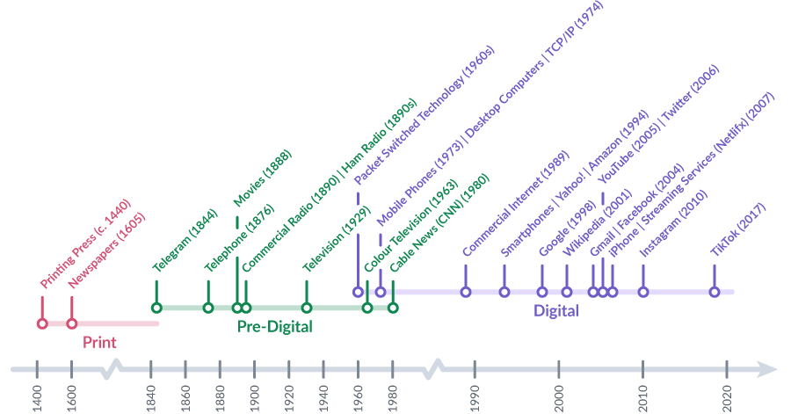
The Internet
The world is linked by a "worldwide web" of electronic networks, and the largest network of all is the Internet
packet-switched" technology was invented by
the U.S. Military for secure comms
and network resiliency in the
event of a major attack

Slide 3
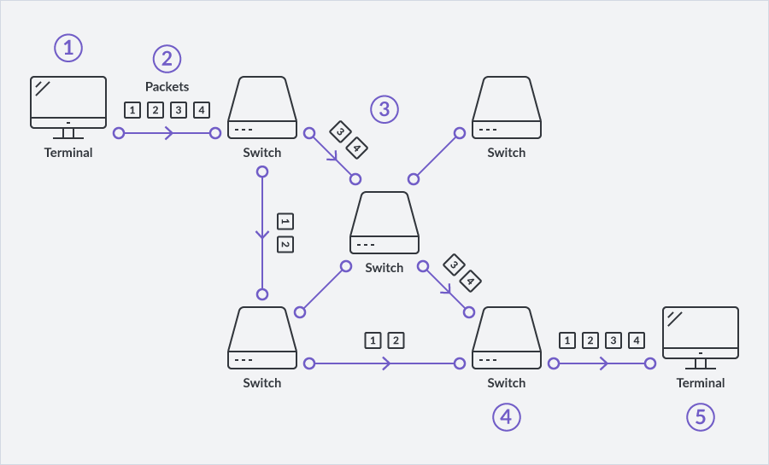
Data Packets
Packets are "chunks" of data that have certain details attached to them that tell devices along the way that says from where it came and to where it is going
An entire message is typed at one end.
It is then broken up into packets containg:
Destination address
Instructions for where it needs to be placed in the reassembled message
The packets takes multiple routes across the network The packets are received at the destination computer And the most important thing: the audience won’t miss the point of your presentation
They are then re-assembled so that they are legible by a computer and a person. Requests for re-transmission are sent for any packets that do not arrive or that arrive damaged.

Slide 4
Data Packets
Packets are "chunks" of data that have certain details attached to them that tell devices along the way that says from where it came and to where it is going
Structure of a Simple Internet Protocol Packet: Email Example
Header | Sender's IP address Receiver's IP address Protocol Packet number | 96 bits
Payload | Data | 896 bits
Trailer | Data to show the end of the packet Error correction | 32 bits

Slide 5

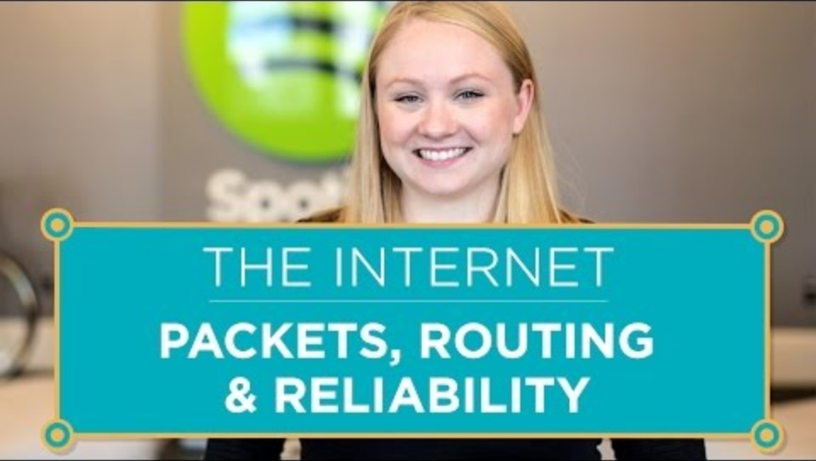
Data Packets
Transmission Control Protocol/Internet Protocol (TCP/IP) packet technology was developed for all networks and devices to use. This universal protocol prepared packets in a standard fashion that all devices could use
Your envelope must be clearly marked with:
recipient, address
Postage
return address
TCP/IP re-creates those standards for the Internet.

Slide 6
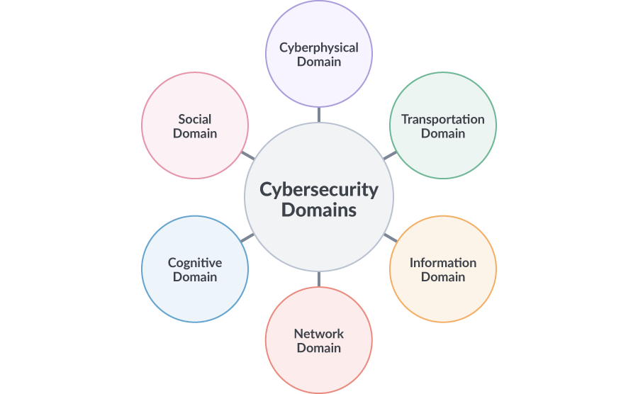
Data Domains
A domain is an area in which there is shared or centralized authority, control, and protection of data and communication within a group or company
Cyberphysical domain - wired network in the organization, the wireless connections in the organization, and the devices that enable interfacing from one domain to another, such as a computer or a device
Transportation - both the information technology and the communication systems used to enable data transfer and communications
Information - using and creating information safely in an organization and also the cybersecurity awareness of the users in an organization
Network - sharing and communicating in an organization
Cognitive - recognizing, analyzing and using data effectively in an organization to solve or prevent cybersecurity issues
Social - how organizations traditionally use and secure their user information, systems, networks and data and how organizations respond to cybersecurity issues

Slide 7

Types of Attackers
If we can recognize the profile of the typical intruder or attacker and that we know how to defend against them:
Attackers Might Be Considered:
Script kiddies
White hat hackers
Vulnerability brokers
Cybercriminals
Hacktivists
State Cyberwarriors

Slide 8
NETWORK PROTOCOLS
Physical and Logical Organization of Networks

Slide 9
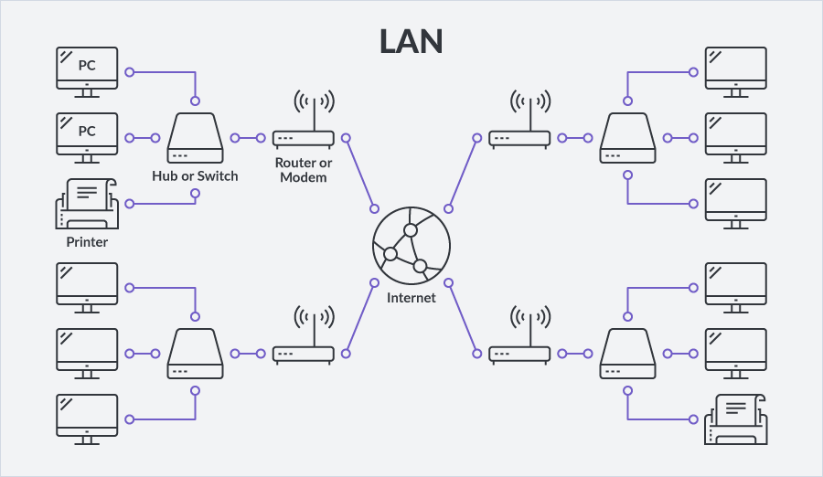
Network Topologies - LAN
The physical map of a system of devices that are joined together, like the Internet, is called its topology. This physical map is also known as its architecture. Network topology maps/diagrams provide a visual representation of a particular electronic digital network
A Local Area Network (LAN) is a group of computers and peripheral devices that share a common physical communications line (e.g., a copper wire or a fibre-optic line) or a wireless (Wi-Fi) link to a server within a distinct and small geographic area or work environment

Slide 10
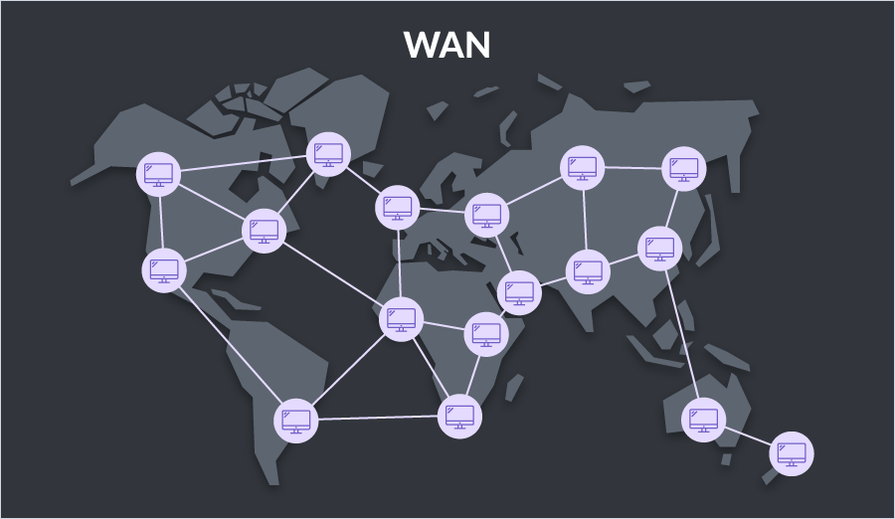
Network Topologies - WAN
A Wide Area Network (WAN) is a telecommunication network that can connect devices from multiple locations that span a city, province, country, or the globe. WANs can link multiple smaller LANs or WANs. The largest WAN is the Internet, which connects numerous smaller WANs worldwide.

Slide 11
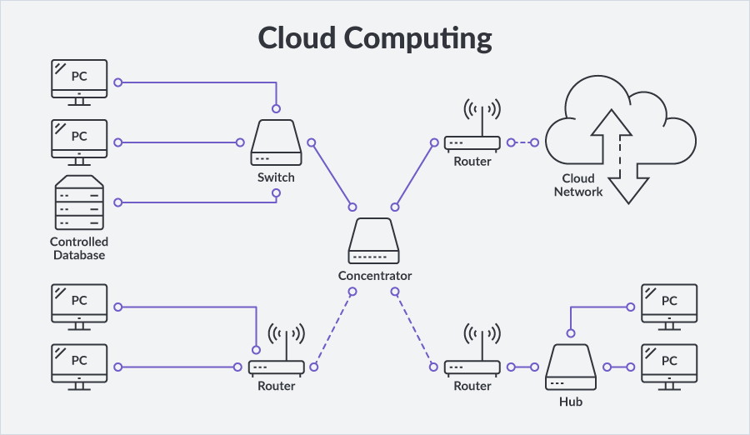
Network Topologies – The Cloud
The cloud is a central resource, like a private server within the same local network or LAN or servers in another external network that exist outside of your own network. These cloud networks are used for the safe storage and access of your data and programs

Slide 12
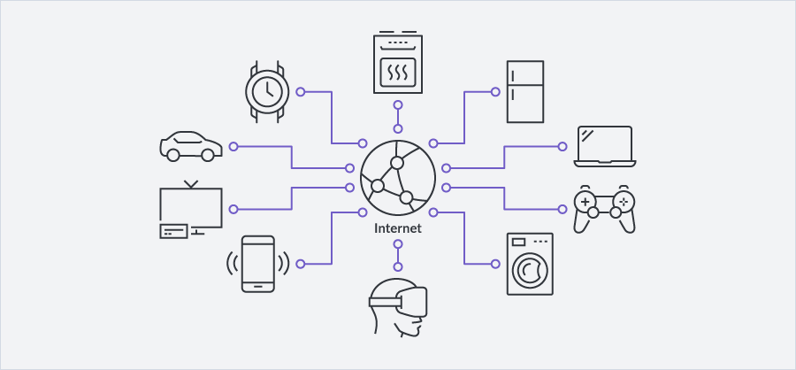
Network Topologies - IOT
Apart from desktop and laptop computers, many other types of devices establish connections to networks and the Internet. For example, smart phones enable us to run applications that perform specific functions like playing a game, using a calculator, or reading a document. Along with these applications, smart phones enable us to communicate over a cellular or Wi-Fi network

Slide 13
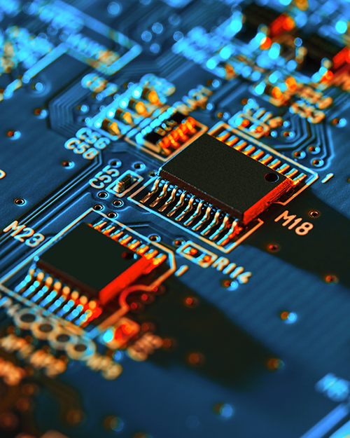
Data Transmission Over Networks
Computers have billions of tiny transistors inside microchips.
Transistors (electrically) turn "on" and "off" with two voltage states (typically measured as 0 volts and 5 volts)
We represent “on/off” states numerically as a "0" and "1".
This binary code ("bi" meaning two different states). Each of these states is called a binary digit (a bit) return address
For example, the letter A in binary is 01000001, and the number 9 is 00111001. These combinations of 8 bits are equivalent to what we call a byte. (8 Bits=1 Byte)

Slide 14
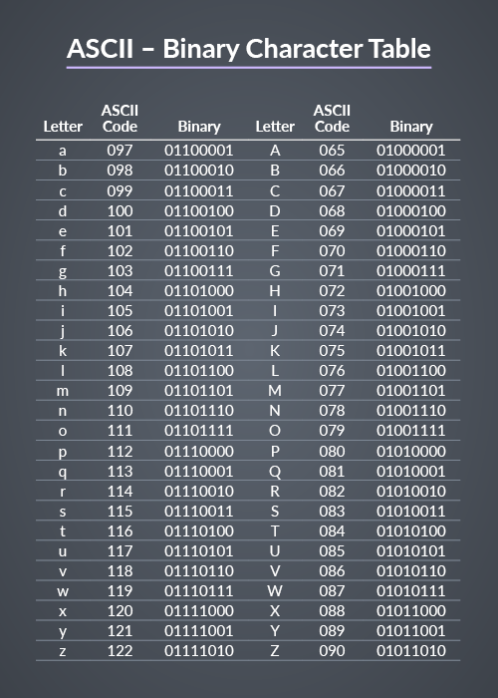
Data Transmission Over Networks
More bits can represent even more complex data like colors, graphic images, music, and so on. The main code system that tells us what these combinations of bits represent is called the American Standard Code for Information Interchange (ASCII) system.

Slide 15
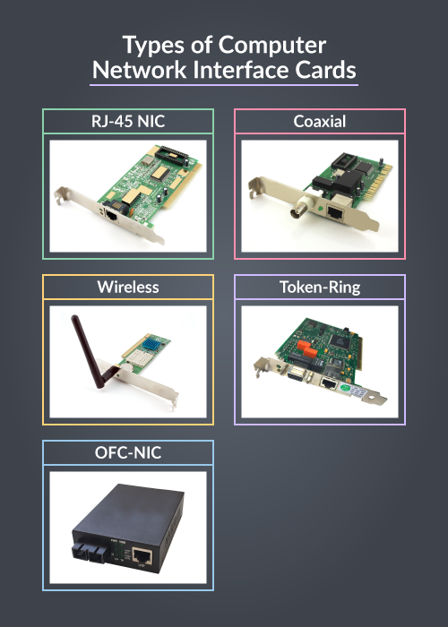
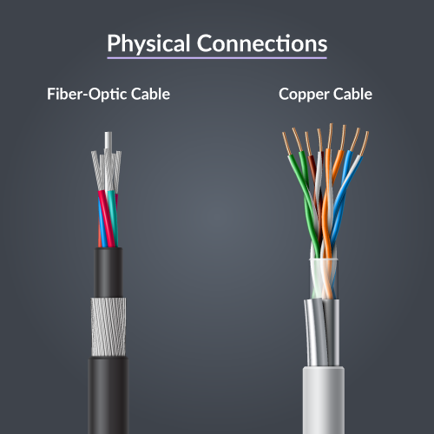
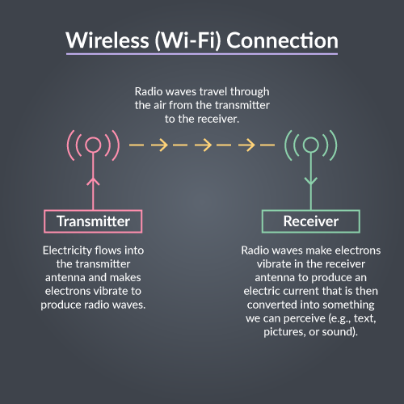
Data Transmission Over Networks
How machines prepare data to share depends on the kind of media that links computers
If the link were a fiber-optic cable, then those bits as pulses of light
If the link were wireless (Wi-Fi), then it would have to prepare those bits as electromagnetic waves that travel through the air
If connected by copper wire, then that computer would have to prepare those bits in the form of electricity

Slide 16
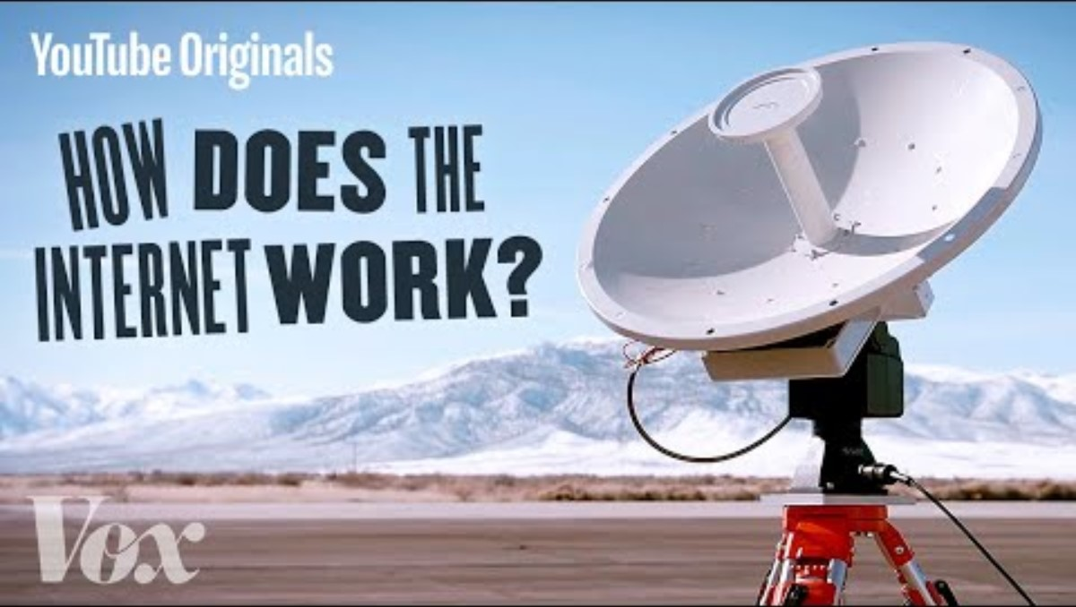

Slide 17
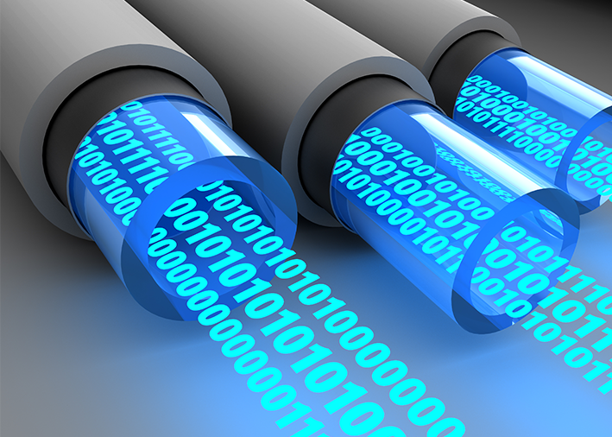
Bandwidth
Unit | Abrv | Equivalence
Bits per second | bps | 1 bps = fundamental unit of bandwidth
Kilobits per second | Kbps | 1 Kbps = 1,000 bps = 10³ bps
Megabits per second | Mbps | 1 Mbps = 1,000,000 bps = 10⁶ bps
Gigabits per second | Gbps | 1 Gbps = 1,000,000,000 bps = 10⁹ bps
Terabits per second | Tbps | 1 Tbps = 1,000,000,000,000 bps = 10¹² bps
Bandwidth is how many bits a device can send and receive at once (its capacity) or in a given period of time. It depends on the type of data being sent and received and the media link used (Sometimes, this is referred to as the size of the "pipe"). Some media can handle more bits at once than others (e.g., a fibre-optic cable has more bandwidth than a copper wire or Wi-Fi)
Bandwidth is measured in terms of the number of bits that can pass through a given point in 1 second. This unit is bits per second (bps)

Slide 18
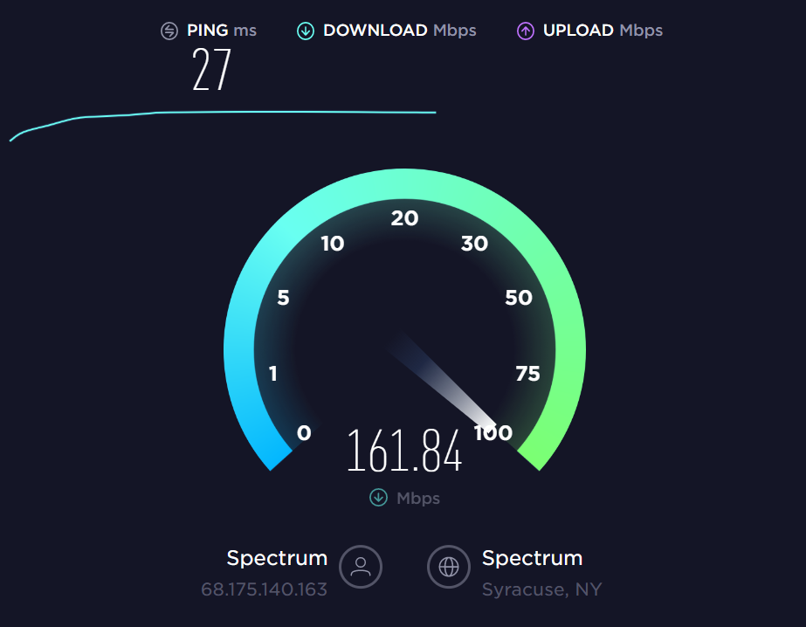
Throughput
In a perfect world, the bandwidth of a network connection—how many bits a device can send and receive at the same time or in a given period of time—would be used to its maximum capacity without any losses of data along the way. In reality, many factors can affect the speed at which bits of digital information travel over network links:
the amount of data
the type of data
the delays caused by the distance and number of devices encountered along the way
These delays are also called latency or lag. Latency is measured in time (seconds), and it includes all of the delays a packet encounters during its travels
The real or actual speed at which bits of data travel over network links and the devices joining them is called throughput. Throughput cannot be faster than the slowest segment of the path those bits of data take from one point to another
Bandwidth = potential speed of a network connection
Throughput = actual speed of a network connection
High latency might indicate a threat acting in your network

Slide 19
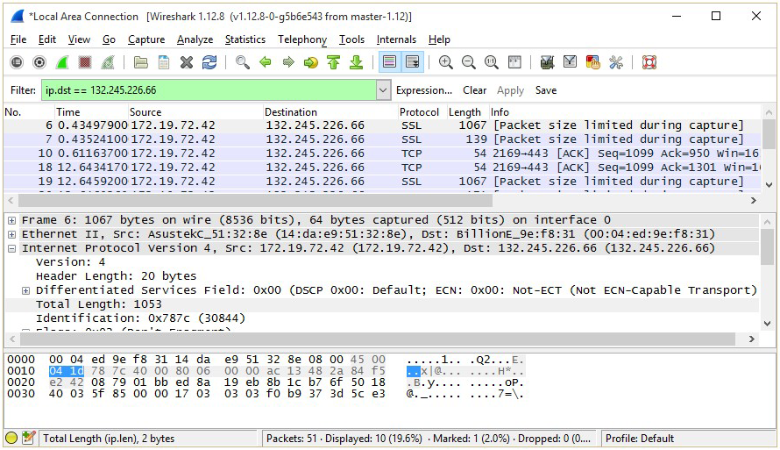
Wireshark
Wireshark enables cybersecurity specialists to look at data packets traveling on a network, do various levels of analysis, and examine reports on this data. It enables filtering to include only the information of interest such as isolating traffic for specific machines. Limitation include:
Wireshark cannot go beyond your network or its domain to analyze the data moving through those other networks
Users must be familiar with networks and protocols
Wireshark provide valid details of issues affecting the network, but it does not provide actual alerts around these issues. User must recognize suspicious activity and raise the alarm themselves
Wireshark cannot decode encrypted or encoded data

Slide 20
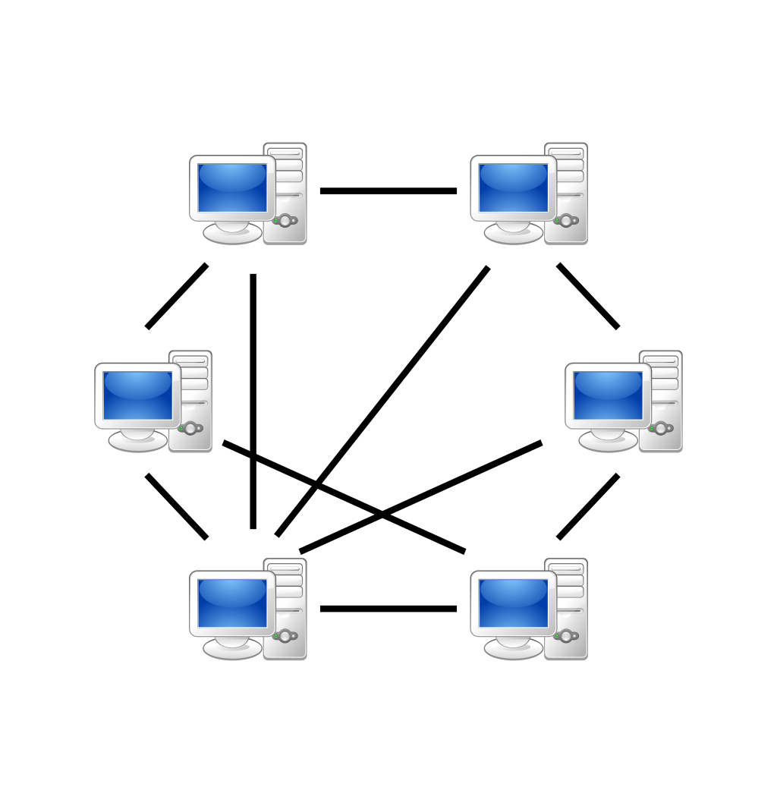
Network Equipment and Infrastructure in LANs and WANs
Clients and Servers
Computers on a network are called hosts because they are related to a user. That user can use the host computer in several roles:
Clients – Request information form servers for more personalized tasks. Viewing websites, downloading/uploading media (files, video etc…)
Server - Provide information to clients, information like files, emails, website delivery, and so on. Servers also enable network administrators to manage the network through a network system platform installed on them
Networks containing machines operating as both client and server are called peer-to-peer (P2P) networks.
The dual role of P2P machines can slow down performance of the computers—and of the entire network
P2P Network

Slide 21
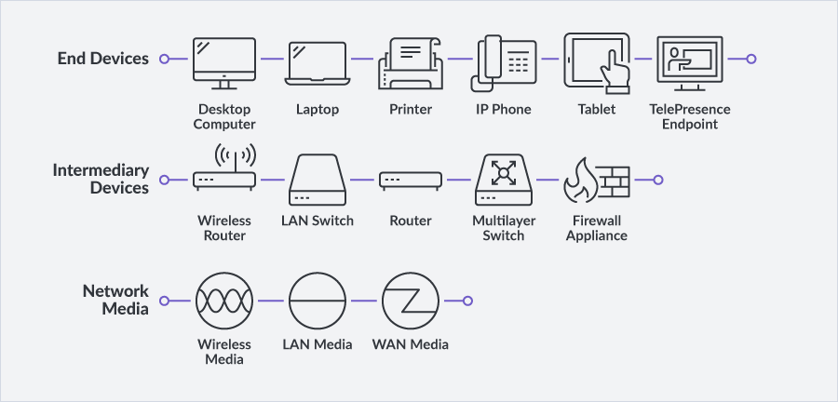
Network End Devices
End devices
Also known as hosts—typically interact with an actual person. End devices include computers, printers, smart devices like cell phones and tablets, cameras, and other peripheral devices that someone can use directly. End devices are usually both the source of a packet and the destination of a packet

Slide 22
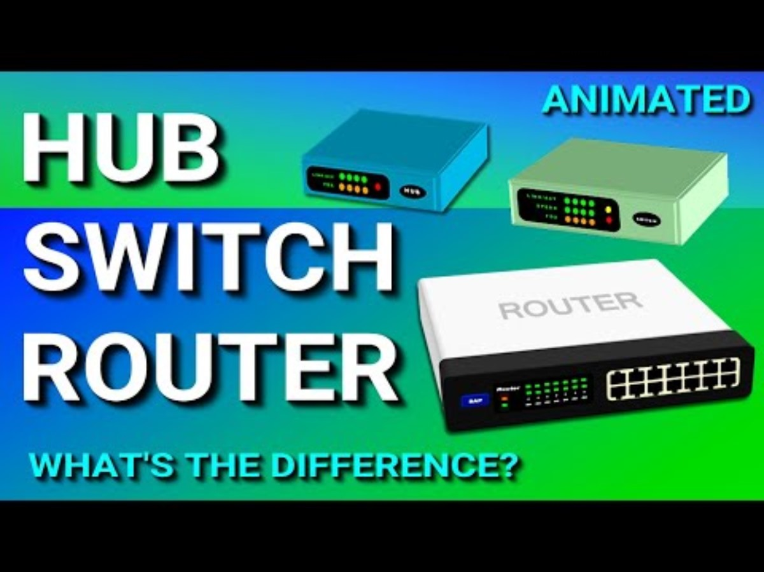
Network Intermediary Devices
Intermediary Devices
connect other devices together on the same network or connect segments of a WAN together. Intermediary devices can even direct the traffic flow of data on the network. In almost every case, a packet sent from an end device travels through an intermediary device to get to its destination host
Hub - Contains multiple ports that can join end devices together. These are passive devices in that they cannot filter packets based on their destination addresses - only the device at the destination address reads the packet
Switch - multiple ports that join end devices together like hubs. A switch is a more active device than a hub. A switch identifies where packets are destined and then forwards those packets out on the ports that should contain the end device on the network
Router - play various roles and can be either hardwired or Wi-Fi. Routers receives packets from a network segment or a whole other network. Routers play major roles in moving data and securing networks
Analyzes the “source” and “destination” addresses on the packet—as well as other pieces of information embedded in the packet
Looks at the possible routes that that packet could take and forwards the packet out through the optimal port interface attached to more routers on another network
If routers on another network have the destination host attached to them, the packet is delivered. If not, the process repeats

Slide 23
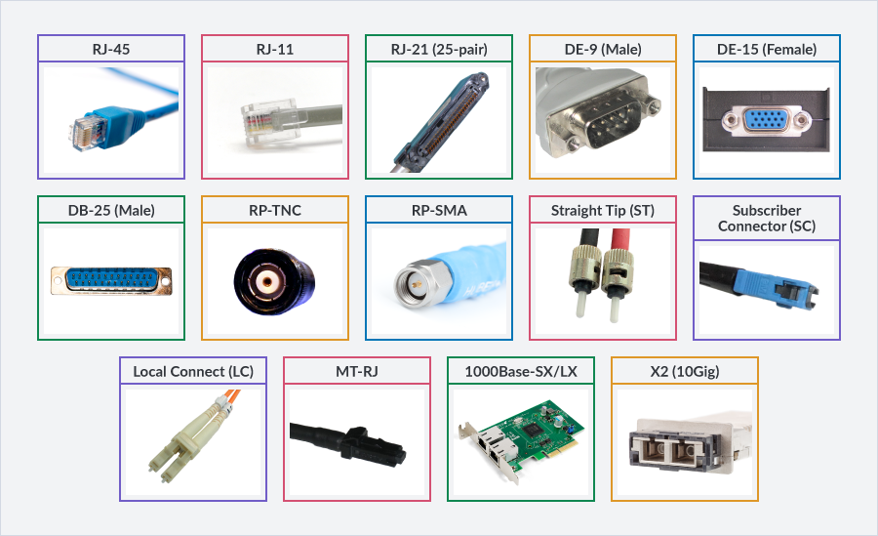
Network Media Connections
Media connections - Material or media that link all devices together on a network, joins multiple local networks together, and connects wide area networks. Media are the cables, wires, and even the electromagnetic radio waves( i.e. WiFi). Different types of media include copper wire, coax cable, light propagating fiber-optic cables:
Ethernet - main standard for physical connections on networks. This standard defines how devices like computers are attached to media and how these devices prepare data to be sent from the device and over media connections
Wireless communication (600-2200 MHz) has been around for over a century, but it has only undergone a revolutionary jump in its influence on daily life during the past 30 years
Bluetooth radio (2.45 GHz) provide connections to speakers, video, and personal devices like watches and smartwatches
NFC – Near Field Communication (13.56 MHz) used for data transfer between devices in close proximity. NFC signals are transmitted at the same frequency as RFID, but with ranges significantly shorter than RFID’s 100-300 feet range

Slide 24
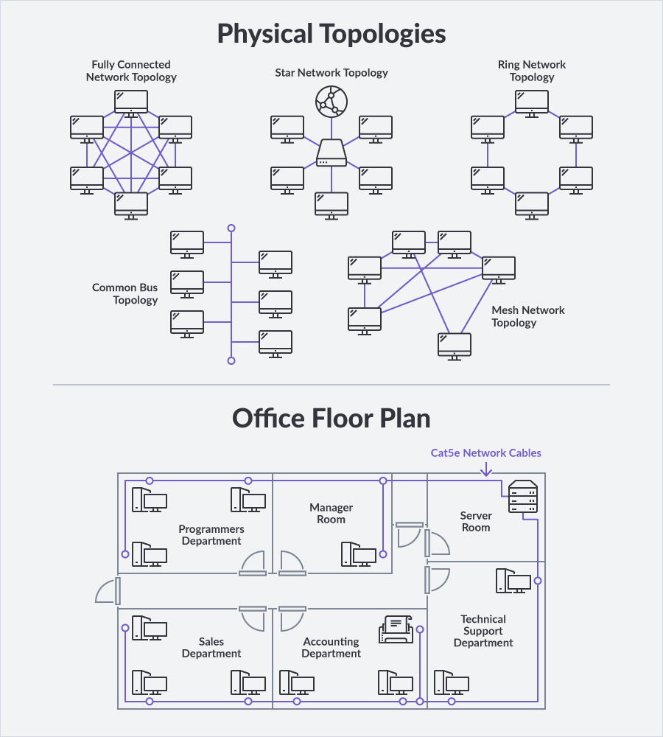
Physical Topology
Visual diagrams or maps are some of the main documents that cybersecurity specialists produce and use. These diagrams reflect the topology of the networks involved. There are two main types of topologies that are drawn on these maps:
Physical Topology – represents the actual physical layout or structure of the networks. A physical topology can be the blueprint for a particular floor in a building, including such information as the following:
layout of offices
specific devices, types of media (wiring) connections, control rooms or wiring closets
room numbers and departments

Slide 25

MAC Address
Media Access Control Addresses (MAC addresses) are typically labelled on a physical topology diagram or identified in a table that accompanies the physical topology diagram. MAC addresses are sometimes also called physical addresses
MAC address is an alphanumeric hexadecimal series of numbers and letters that are embedded either in the NIC of the device or in the physical interface that attaches the device to the network. This address never changes, it accompanies the device regardless of the location of the device (unless it is spoofed using types of NICs/Adapters)
The first part of the MAC is the Organizational Unique Identifier (OUI) identifies the manufacturer of the device. The second is a unique identifier or serial number for that particular device.
Lookup your devices MAC (ipconfig on windows terminal or ifconfig on linux terminal)

Slide 26
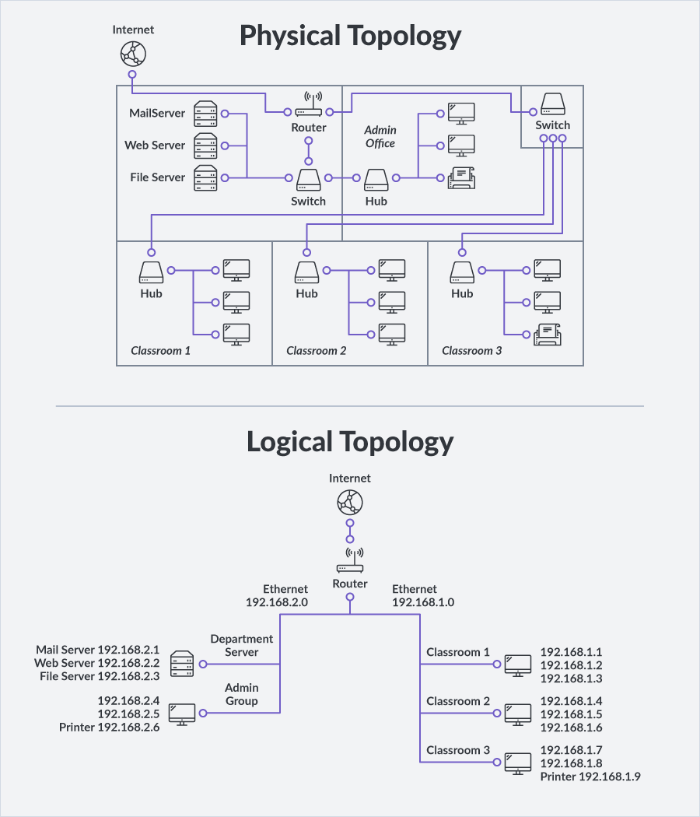
Logical Topologies
The information in a logical topology doesn't necessarily show the exact location of a device, but it can reveal it indirectly. A logical topology prioritizes the movement of data inside the network. Information listed might include:
name of device (e.g. “Mail Server", “NAS“, etc)
IP address (e.g. 192.220.2.135)
Internet Protocol (IP) - IPs provide specific information about the location of the device to the intermediary devices along the way. It is the “mailing address” needed to deliver data packets.
IP addresses can be manually set by a user in a device (called a "static" or "fixed" address), or they can be “dynamically” assigned by another device, typically a server or router

Slide 27
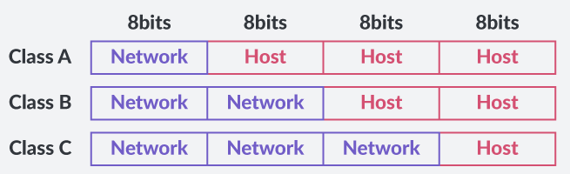
IP Addresses
IP addresses (IPv4) have four numbers in it, each separated by a dot.
Each number is called an octet because it is made up of 8 bits in binary
IP address contains a total of 32 bits
First octet identifies the network and the remaining octets identify the possible subnetwork ("subnet"), as well as the host device or computer itself
The router applies a subnet mask over the address to reveal whether or not the host address actually does belong to a subnetwork
192
.
168
.
1
.
32
cmd -> ipconfig ->
XXXXXXXX . XXXXXXXX . XXXXXXXX . XXXXXXXX

Slide 28
IP Addresses – Converting Binary Code
Octet 1 | Octet 2 | Octet 3 | Octet 4
8bits | 8bits | 8bits | 8bits
XXXXXXXX | XXXXXXXX | XXXXXXXX | XXXXXXXX
8 Bit = 1 Byte
One Bit (“0” or “1”)
Octet 1 (Class C)
128 | 64 | 32 | 16 | 8 | 4 | 2 | 1
1 | 1 | 0 | 0 | 0 | 0 | 0 | 0
1 | 1 | 0 | 1 | 1 | 1 | 1 | 1
128 + 64 = 192
128+64+16+8+4+2+1 = 223

Slide 29
IP Addresses
Class A networks can contain many more subnets and hosts than a Class B or Class C network
Bits from the host portion of the overall IP address are borrowed from left to right starting with the left-most bit
Five Different Classes of IPv4 Addresses
Class | First Octet Decimal (Range) | First Octet Binary (Range) | IP Range | Subnet Mask | Hosts per Network ID | Number of Networks
Class A | 0–127 | 0XXXXXXX | 0.0.0.0–127.255.255.255 | 255.0.0.0 | 2²⁴–2 | 2⁷
Class B | 128–191 | 10XXXXXX | 128.0.0.0–191.255.255.255 | 255.0.0.0 | 2¹⁶–2 | 2¹⁴
Class C | 192–223 | 110XXXXX | 192.0.0.0–223.255.255.255 | 255.255.255.0 | 2⁸–2 | 2²¹
Class D(multicast) | 224–239 | 1110XXXX | 224.0.0.0–239.255.255.255
Class E (exp.) | 240–255 | 1111XXXX | 240.0.0.0–255.255.255.255

Slide 30
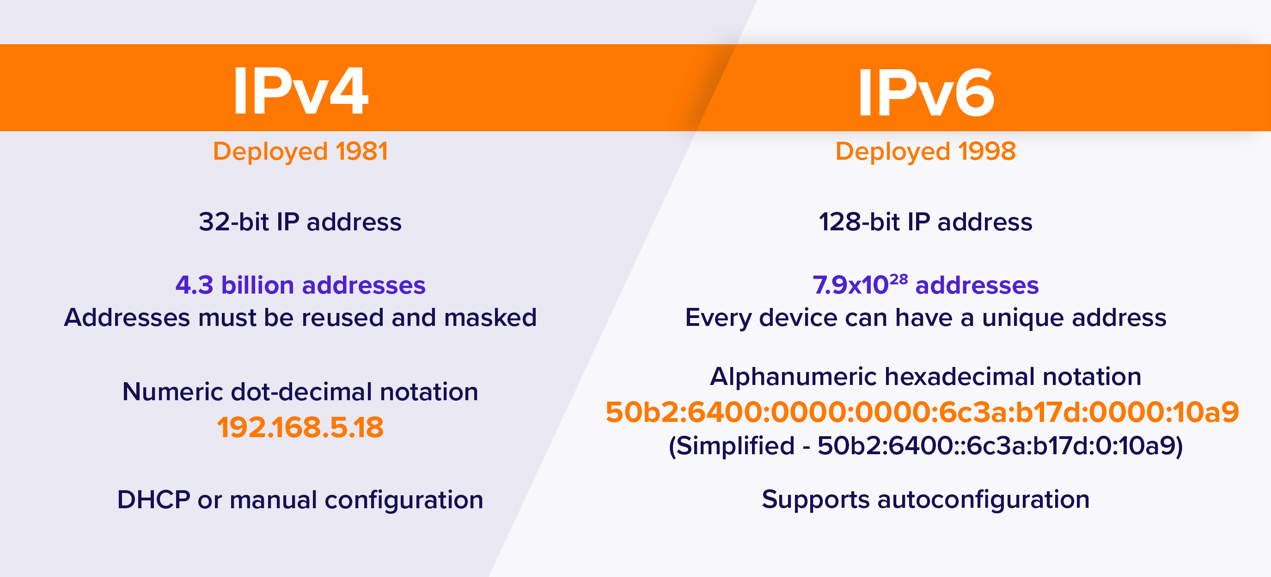
IP Addresses – IPv4 versus IPv6
Once the packet arrives at that organization's network, the intermediary devices (e.g., routers) on that network look at any subnet information in the IP address because that particular local network might be divided into those smaller subnetwork segments ("subnets")
IP Address + MAC Address give sufficient information for the packet to be delivered to the destination host
IP Version 6 – IPv6 is an attempt to solve the problem of the high demand for IP addresses because of all of the connected devices in the global Internet of Things.
IPv6 has 16 octets (128 bits) in its address (versus 4 octets or 32 bits)

Slide 31
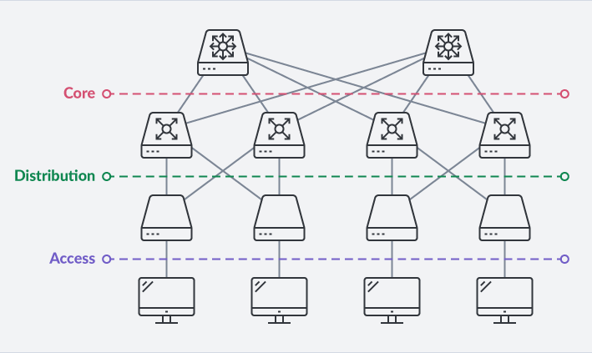
Network Hierarchy
Local internal networks (usually within an organization) are structured by different layers of distribution and management so it is easier to manage, operates more efficiently, and improves security
Access layer - provides connections to hosts in a local Ethernet network (especially within subnetworks) by switches
Distribution layer - connects smaller local networks together by using more sophisticated devices. These more powerful switches and routers have more control of the type of traffic that flows in and out of the smaller access layer subnetworks to the core layer
Core layer - provides a high-speed powerful connection between the distribution layer devices and the outside WANs like the Internet. Core devices provide not only increased management and control of the flow of massive amounts of data but is done at incredible speeds

Slide 32
Network Protocols and Standards
There are two parts of the traffic rules for data on networks. Protocols and Standards. Protocols are the rules for communication, and standards are the expectations of the industry for devices and their software to follow.
STANDARDS: Central organizations set these standards. Some include:
Internet Assigned Numbers Authority (IANA) – assigns IPs
Institute of Electrical and Electronics Engineers (IEEE)
International Organization for Standardization (ISO)
PROTOCOL: The communication process involves three elements and a method of communication :
Sender - client or the source of the message
Receiver - client or the destination of the message
path or medium - the message must travel through to get to its destination—everything in between
MESSAGE FORMAT: What the format and structure of the message (i.e. encoding) ?
The Protocol Stack
Preparing, transmitting, and receiving digital information form a process. Industry models this process as a "stack" or a hierarchical structure.
Each stage of the process is placed in order as it happens, one after the other. Processing is performed by the operating system and ancillary programs

Slide 33
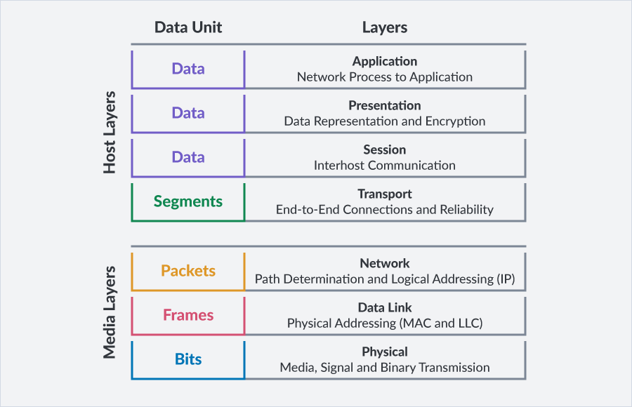
OSI Reference Model
General model for data transmission is the Open Systems Interconnection (OSI) Reference Model developed by the ISO.
The OSI model has seven layers. Each layer is dependent on the one before it, but it still functions on its own
Data packet must go through each layer, where specific packaging tasks are performed on the data, before being sent from a source computer to a destination computer
Data is transmitted out through the medium and intermediary devices before arriving at the destination IP
The process is repeat to reassemble the complete data file
Think how a letter is mailed:
Get a pen and paper
Writing a letter
Folding it
Place it inside an envelope (a frame)
Writing your address and the destination address on the front of the envelope (along with a list of contents inside), sealing it
Placing a stamp on it
Bring it to the post office
PACKETS
COMMUNICATION

Slide 34
OSI Model – Media Layers
Physical - Physical layer protocols focus on the form that the bits of data (binary 0s and 1s) must take for them to be sent out of the computer on to the attached medium. The data must be converted to electricity, light, radio waves by physical interface of the host’s NIC. Data is transmitted out through the medium and intermediary devices before arriving at the destination IP
Data Link - Data Link layer protocols define how data frames are transmitted between devices that share the same type of medium. Ethernet protocols are the most common protocols for networks. This is where MAC addresses are identified
Chunks of data called frames are created in this layer by the Logical Link Control (LLC) sublayer which are passed to the next layer for packet creation
Network - Network layer protocols help to provide more sophisticated addressing of the frames that are passed on from the Data Link. IP addresses are attached to frames. New encapsulated chunks of data are called packets.
addresses attached to each packet can be updated as they move from device to device and network to network until reaching their final destination according to the next device or network. Each new network along the route is called a hop – this work is done by the router
Imagine driving to Vancouver from Fredericton only knowing the way to the next city..then the next city…then the next in “hops”
Lower level protocols
within the Host’s NIC

Slide 35
OSI Model – Host Layers
Transport - Considered a lower layer because it deals mostly with the actual format and movement of the packets through networks. The Transport layer performs the function of breaking up these chunks of data, but it is processed deeper within the end host such as the computer's operating system. For this reason, the Transport layer is considered more as part of the upper host layers. Transmission Control Protocol (TCP) and User Datagram Protocol (UDP) are the most common Transport Layer protocols
Session The Sessions layer protocols manage the exchange of communication data going back and forth in an orderly way. – random requests would be chaos. Session layer will ensure communication occurs in sequence without altering the data being transmitted.
Presentation - Presentation layer protocols focus on what data looks like when it is being passed from one host to another. The well known protocols that deals with transmitting and receiving of web page data - Hyper Text Transport Protocol (HTTP) – operates on the Presentation layer to render HTML
Application - Application layer protocols are determined based on the application itself that is creating and processing the data for the host computer and its user. It is considered the protocol layer that is closest to the user.
Considers the availability of both hosts to communicate with one another
Authenticates the requests coming in from other hosts and their applications
Performs privacy checks of the data.
Checks the integrity of the data
Performs error recovery of the data

Slide 36
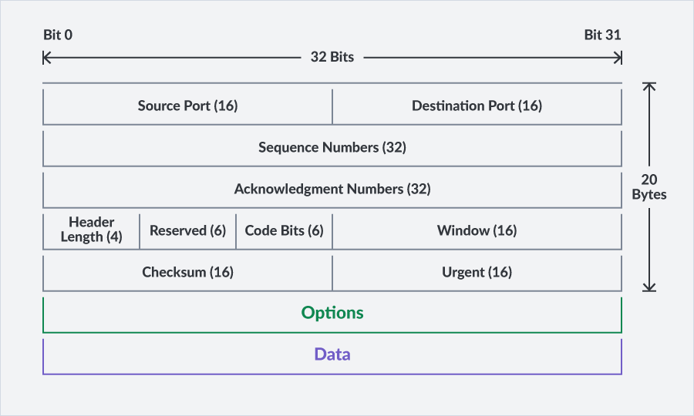
TCP/IP Protocol
Transmission Control Protocol (TCP) - Based on the same principles as the Network Control Protocol (NCP) developed for ARPANET – the earliest version of the modern internet.
TCP makes software-based connections between computers before the data itself is even sent. The idea was that a computer (e.g., a server) would be constantly listening to the network for requests coming in from another computer (e.g., a client). When a request was received, the server would respond and be ready to accept the transmission from the other computer. This is called “handshaking”
Packet Datagram Unit (PDU)
TCP would prepare all the parts of the packet—called a Packet Datagram Unit (PDU) – consisting of:
Header (20 bytes):
Contained the source and destination addresses (32b)
Sequence number indicating where data fragment falls in order of all the packets that make up the entire message (96b)
Functions to check for errors (32b)
Data (896 bits)

Slide 37
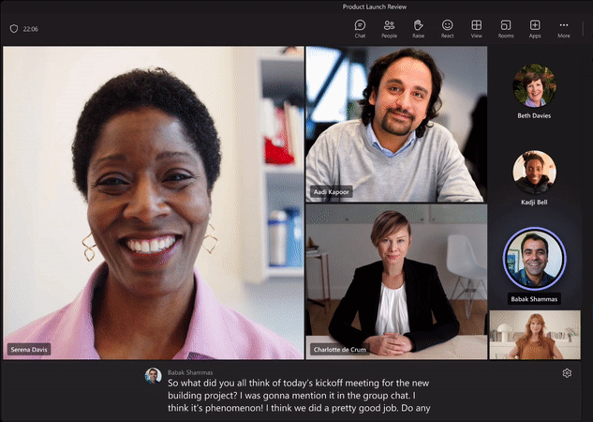
User Datagram Protocol (UDP)
UDP is not part of the more reliable TCP protocol stack
UDP is used when the bigger demands of resources by TCP are not needed. TCP's acknowledgement receipt requests having to be answered for every packet.
Live streaming of audio and video over the Internet does not require TCP acknowledgements for every single packet. This process would slow down transmission.
Streaming relies on UDP because it is a "best effort" (but not guaranteed) protocol to get packets to their destinations.
If a few packets are lost, then the application simply continues the live broadcast with a small interruption.
UDP does not avoid interruptions; it just does not make those interruptions longer as TCP would
UDP is a "best effort"

Slide 38
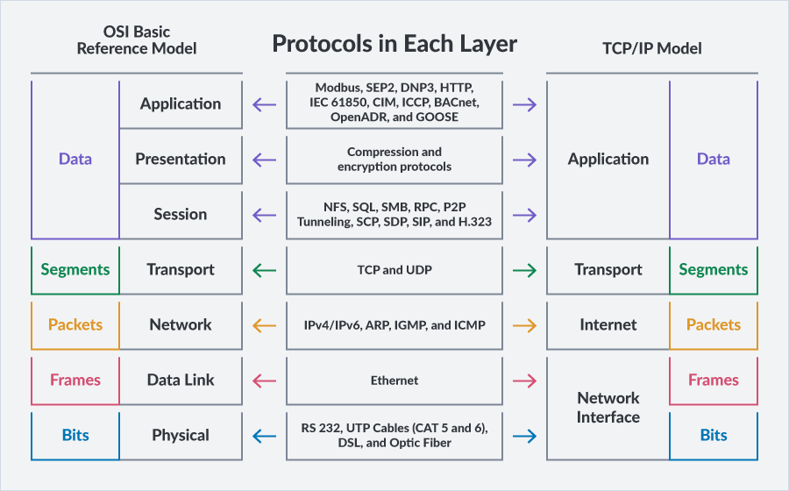
Port Numbers & TCP/IP
Either TCP or UDP system assigns port numbers to packets to keep track of the specific conversations taking place between a server and a client
IP addresses - Provide unique identifiers (IDs) for the sending and receiving networks, any subnetworks within that destination network, and the particular sending and receiving computers/intermediary devices along the way to the final destination network
Combining both an IP address and a port number in a packet creates a socket. You can identify a socket by the IP address (e.g., 192.168.3.7) and port number (e.g., port 80) and is written like 192.168.3.7:80

Slide 39
NETWORK PROTOCOLS
Observing Network Traffic

Slide 40
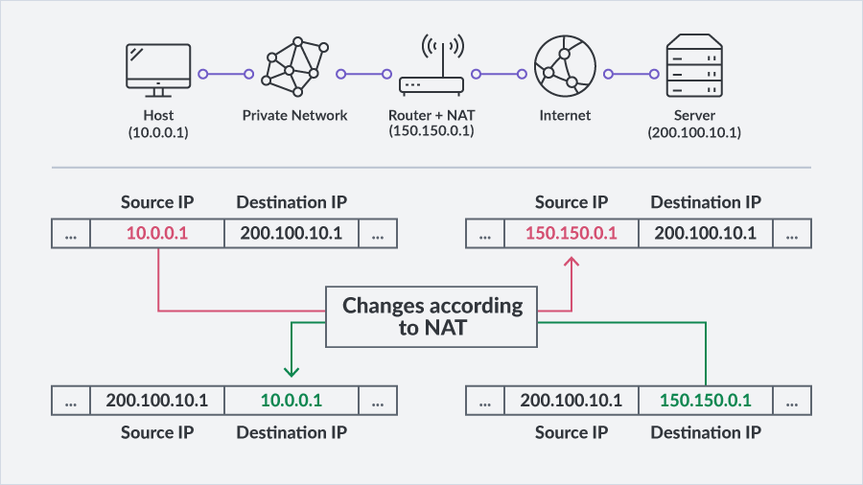
Name Address Translation (NAT) Protocol
Static IP addresses - Pre-determined and configured manually in the device or computer by a user or network IT administrator
Dynamic IP addresses - Temporarily provided by a network management device like a server or router every time the computer is started up and accesses the network. These servers or routers tend to use the Dynamic Host Configuration Protocol (DHCP) operations to provide those temporary addresses to devices in the network
Name Address Translation (NAT) Protocol
Many organizations and home-based networks use private IP addresses that cannot be visible to the outside world. They cannot be recognized and accepted beyond the local network
The NAT protocol consolidates all of the internal private addresses into one single public address that can be used for external communications and is visible to anyone outside that local network.
Home routers are attached to an external gateway to the Internet such as an Internet Service Provider (ISP)

Slide 41
Routing Tables
A router’s “routing tables” (“cache”) lists the networks directly and indirectly attached to each of its ports
Routing tables are stored in the routers non-volatile memory (NVRAM) so the information is not lost even if the router looses power
Each port's routing table uses Address Resolution Protocol (ARP) protocols to monitor and to renew those tables as it receives updates from nearby devices on a regular basis
Devices on the local network also send out ARP broadcasts to learn about other locally attached networks devices, such as other computers, to ask for the MAC address of an unfamiliar IP address
If another device is familiar with that unknown IP address and the corresponding MAC address attached to it, it passes on that information on behalf of the unknown device or sends that information to the MAC address of the default gateway port attached to the nearest router
Routers focus more on Layer 3 IP address information for packets with destinations outside the local network (i.e. Webservers)
Along with MAC addresses, routers create "maps" of routes taken from the routing tables, along with the other pertinent information. Then, they use these maps to get packets as close to their destination as possible
Routing Tables Contain (At Least) The Following Information:
IP addresses of distant devices and their respective networks
address or name of the next router down the line outside the network (called a hop) to get to a particular network
The port ID in the router that connects to that next hop along that route
A timestamp to show when that update packet was received and processed
A metric to measure how long to or how far from the destination the packet is, such as the number of hops or routers along the way or time in milliseconds

Slide 42
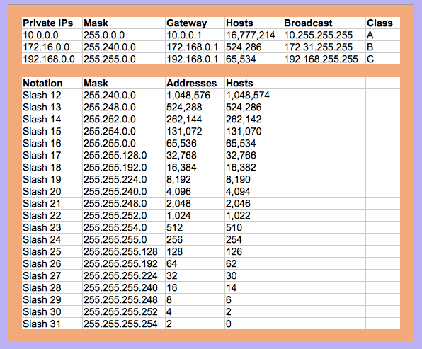
Subnet Mask Slash Notation
Octet 1 | Octet 2 | Octet 3 | Octet 4
8bits | 8bits | 8bits | 8bits
XXXXXXXX | XXXXXXXX | XXXXXXXX | XXXXXXXX
8 Bit -> /8
24 Bit -> /24 == 255.255.255.0 subnet mask

Slide 43
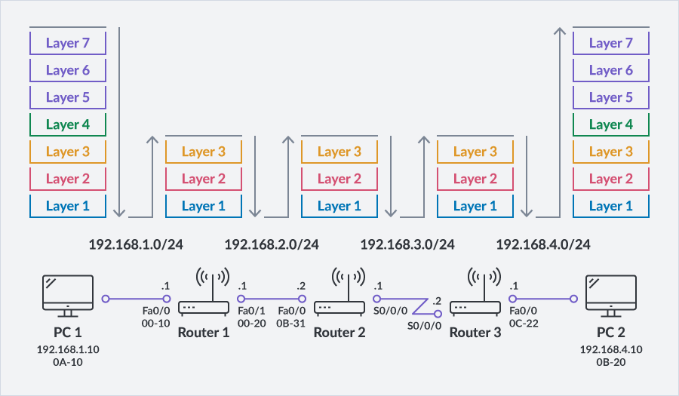
Routing Path Selection
As packets are distributed over a network along paths towards their destinations by routers. Routers receive a packet and analyze the Layer 3 IP address information contained in it to move the packet further along in a direction, to the next routers to its final destination host:
After receiving a packet and reading the network portion of the Layer 3 IP address of the final destination network
Preparing a Hop for a Familiar Address:
If the router is familiar with the network address, it prepares Layer 2 MAC information of the port it is leaving from and the MAC address of the next router port, or hop, to which it is going, and any other pertinent Layer 3 IP information.
The packet gets re-encapsulated and sent via the router port familiar with that IP address in the packet and its corresponding network/subnetwork.
The only address piece of the packet that gets updated is the MAC address of the sending router port and the MAC address of the next port along the way (receiving port of the next router)
MAC addresses were shared by other devices and are stored in the ARP tables

Slide 44
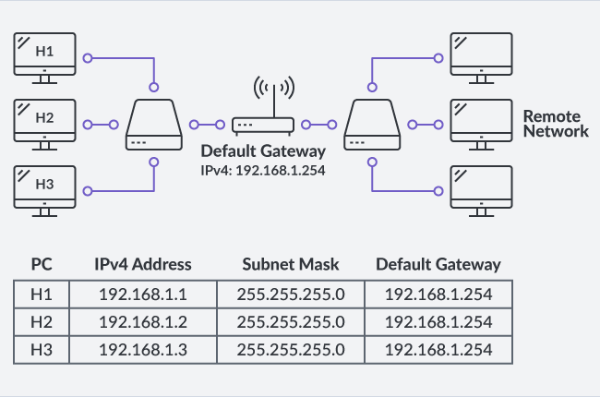
Routing Path Selection
Preparing a Hop for a Familiar Address:
If the router is not familiar with the address, it will send it out through the pre-defined Default Gateway router port to the next router that may be familiar with the IP address.
Usually, the IP address of the Default Gateway is pre-determined and static
It is used in a router closest to local networks where that gateway is the "door" to the Internet for the users within the organization

Slide 45
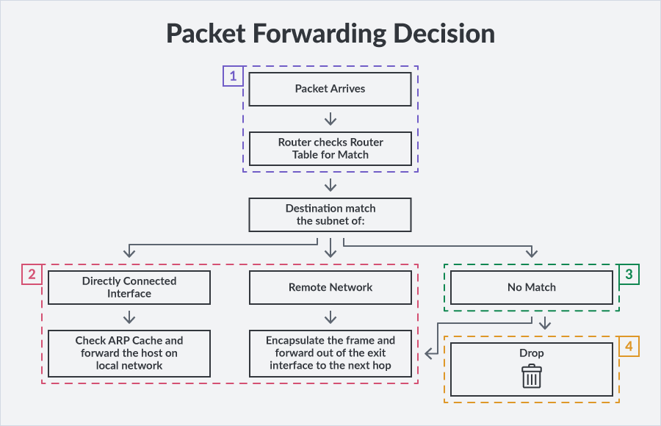
Routing Path Selection
Dropping a packet:
If a router cannot find the appropriate route to forward the packet after a certain period of time or number of attempts to reach it, it will simply drop it

Slide 46
Revisiting IP Address and Subnetting
An IP address is structured such that it contains three key pieces of information:
(1) Network Address ID (2) Subnetwork Address ID (if it exists, Default Subnet Masks are shown in the table (3) Client/Device MAC Address
Different Classes of IPv4 Addresses
Class | First Octet Decimal (Range) | First Octet Binary (Range) | IP Range | Subnet Mask | Hosts per Network ID | Number of Networks
Class A | 0–127 | 0XXXXXXX | 0.0.0.0 -127.255.255.255 | 255.0.0.0 | 2²⁴–2 | 2⁷
Class B | 128–191 | 10XXXXXX | 128.0.0.0–191.255.255.255 | 255.0.0.0 | 2¹⁶–2 | 2¹⁴
Class C | 192–223 | 110XXXXX | 192.0.0.0–223.255.255.255 | 255.255.255.0 | 2⁸–2 | 2²¹
192.168.10.15/27
Host Address
Subnet Mask
Octet 1 | Octet 2 | Octet 3 | Octet 4
192 | 168 | 10 | 15
11000000 | 10101000 | 00001010 | 00001111
Octet 1 | Octet 2 | Octet 3 | Octet 4
255 | 255 | 255 | 224
11111111 | 11111111 | 11111111 | 11100000

Slide 47
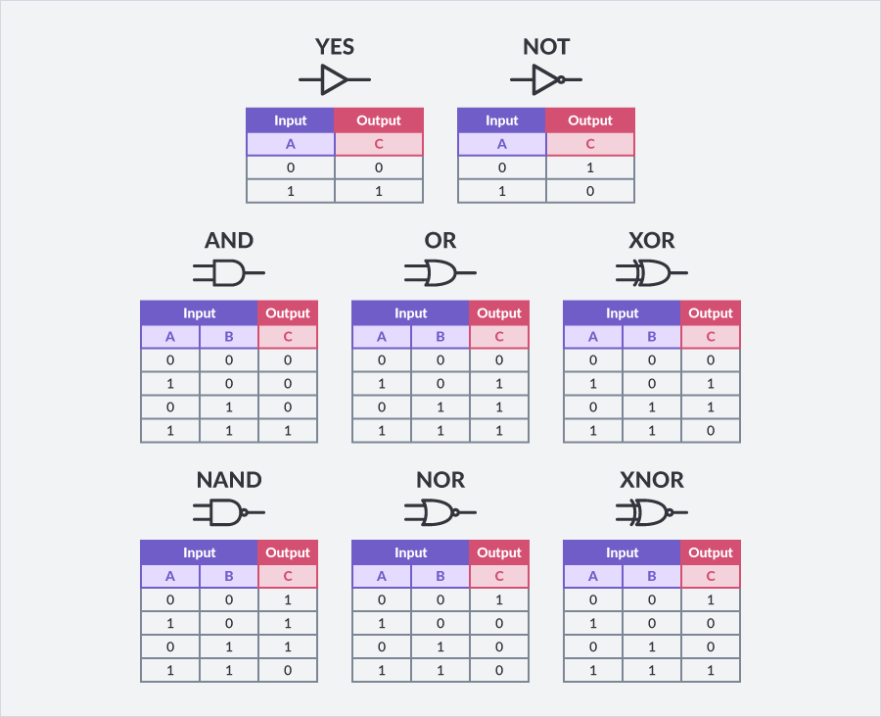
Revisiting IP Address and Subnetting
Class C Allowed Network Topology
192.168.10.15/27
24bits | Network | 2²⁴
3bits | Subnet | 2³ = 8
5bits | Hosts | 2⁵ = 32
 | Octet 1 | Octet 2 | Octet 3 | Octet 4
Host IP | 11000000 | 10101000 | 00001010 | 00001111
Subnet Mask | 11111111 | 11111111 | 11111111 | 11100000
AND logical operation Applied By Router To ID Subnet
Subnet ID (Binary) | 11000000 | 10101000 | 00001010 | 00000000
Subnet ID (Decimal) | 192 | 168 | 10 | 0
2³ Available Subnet ID
# | Subnet Address Range
0 | 192.168.10.0 | 192.168.10.31
1 | 192.168.10.32 | 192.168.10.63
2 | 192.168.10.64 | 192.168.10.95
3 | 192.168.10.96 | 192.168.10.127
4 | 192.168.10.128 | 192.168.10.159
5 | 192.168.10.160 | 192.168.10.191
6 | 192.168.10.192 | 192.168.10.223
7 | 192.168.10.224 | 192.168.10.255
The router determines that the host belongs to subnet ID# 0 and forwards the packet to the next next intermediary device in that subnetwork
Then that subnet's router or switch, knowing the MAC address of that particular host, sends the packet to everyone in the subnet.
Only Device 192.168.10.15 with correct MAC address will process the entire packet’s message. The rest of the devices in the subnet will simply ignore it

Slide 48
Example - IP Address and Subnetting
Class C Allowed Network Topology
172.16.2.10/25
24bits | Network | 2²⁴
1bits | Subnet | 2¹ = 2
7bits | Hosts | 2⁷ = 128
 | Octet 1 | Octet 2 | Octet 3 | Octet 4
Host IP | 10101100 | 00010000 | 00000010 | 00001010
Subnet Mask | 11111111 | 11111111 | 11111111 | 10000000
AND logical operation Applied By Router To ID Subnet
Subnet ID (Binary) | 10101100 | 00010000 | 00000010 | 0000000
Subnet ID (Decimal) | 172 | 16 | 2 | 0
2³ Available Subnet ID
# | Subnet Address Range
0 | 172.16.2.0 | 172.16.2.127
1 | 172.16.2.128 | 172.16.2.255
The router determines that the host belongs to subnet ID# 0 and forwards the packet to the next next intermediary device in that subnetwork
Then that subnet's router or switch, knowing the MAC address of that particular host, sends the packet to everyone in the subnet.
Only Device 192.168.10.15 with correct MAC address will process the entire packet’s message. The rest of the devices in the subnet will simply ignore it

Slide 49
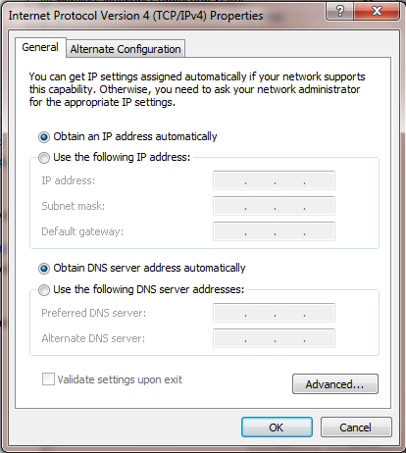
Configuring and Viewing TCP/IP in Windows
Manually configure a fixed static IP address or obtain one automatically as a dynamic IP address when the computer starts up.
A subnet mask can be declared, which informs the computer that it is part of a subnet
Default gateway can be declared, which is the default address when the computer is sending packets to networks outside that particular (i.e. Internet)
Domain Name Server (DNS) can be given for translating a website address into an IP address to attach to the packets generated by the computer's web browser
ipconfig ("Internet Protocol configuration") - command entered at a command prompt window which can gather key pieces of network information for that particular Windows computer

Slide 50
NETWORK TOOLS

Slide 51
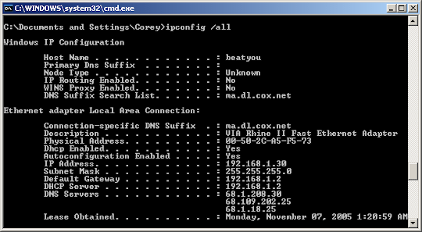
ipconfig
The ipconfig command provides an overview of the local network with IP and MAC address information, servers, and certain protocols. An example of ipconfig with a tag is ipconfig /all

Slide 52
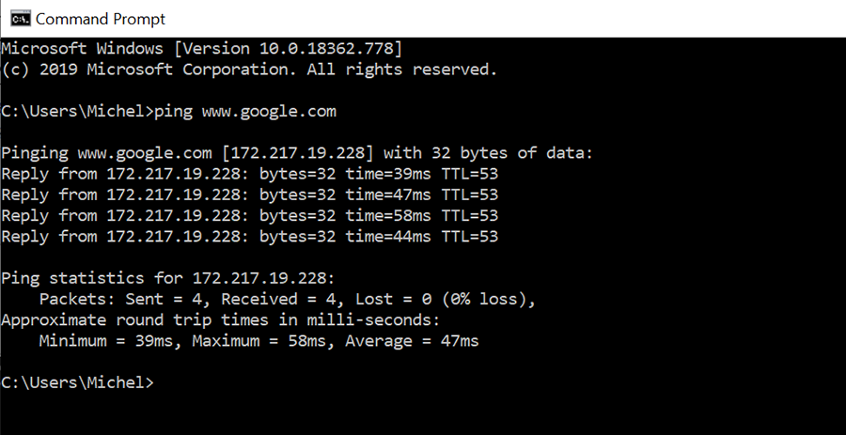
ping
The ping command tests the connection (connectivity) between two end points by using the IP address of a destination network and host. If the ping command is successful, the feedback provided reveals how long it took for the request to leave the source and arrive at the destination and the response to come back. One advantage of ping is that you can use it to isolate part of the network to just test the connectivity between two systems, such as a wireless or a wired connection to the default gateway or an Internet access point: e.g., ping 10.10.10.1.

Slide 53
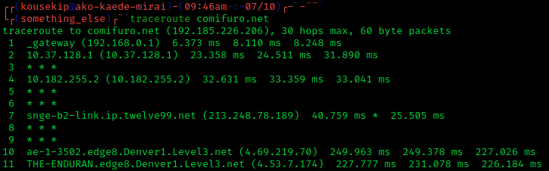
tracert/traceroute
The tracert/tracerroute command is very similar to ping, but it provides more details about the parts of the path in between the source and destination end points. It breaks down the router hops along the way to identify additional information about the path:
how long reaching a hop takes
how long it takes to come back
whether a hop device fails to respond
whether a hop device forwards the packet anyway when it fails to respond

Slide 54
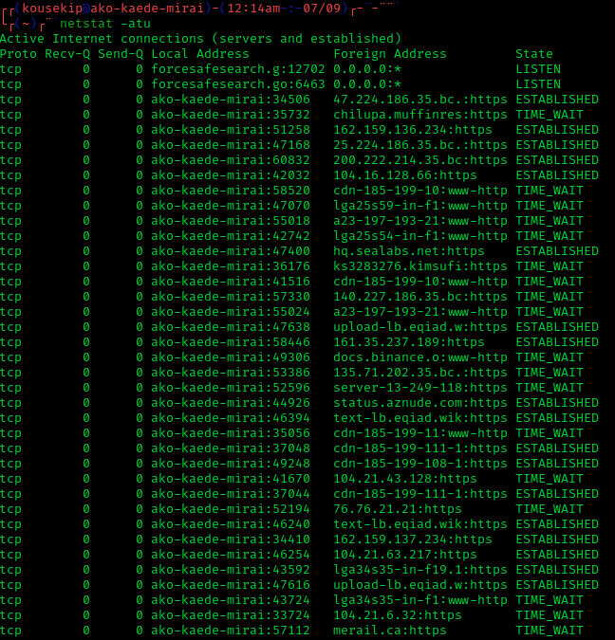
netstat
Transport layer protocols is an essential part of monitoring who and what has an established connection with the host computer. One of the most common ones for establishing these connections is TCP.
You can use this command to verify if a connection is legitimate or not. The netstat command list the following information about the TCP connections:
the protocol
the address (and port number if applicable) of the TCP connection
the address of the host at the other end
the current status of the connection (i.e., whether it is live and active ["established"])
The netstat command displays the results dynamically and "live" continuously, so stopping the process might require a break command. The keystroke combination Ctrl-X will do that.
There are several reasons why monitoring Transport layer protocols is important. If there are a lot of TCP connections that are useless and not required, then they can slow down network performance. Moreover, identifying questionable and unrecognizable connections to the network can mean that there is a security concern that requires further investigation.

Slide 55
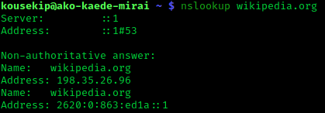
nslookup
The nslookup command identifies the server that is resolving website names into numerical IP addresses. This command enables you to test the names of websites and networks to confirm that the Domain Name Server (DNS) is performing properly

